Slide 1
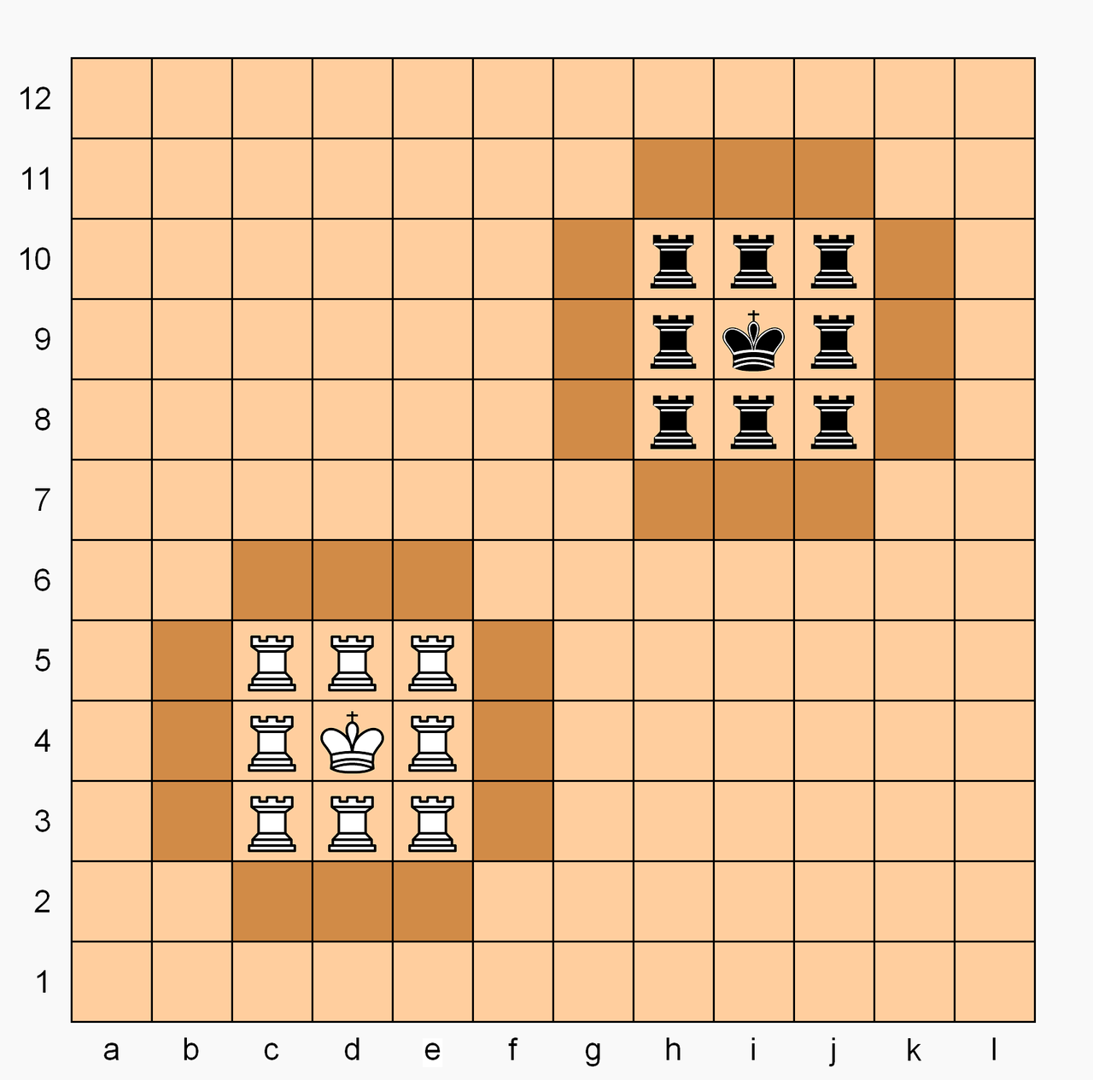
P5: Final Project - Chad
Team name: Function;Chaos
Team members: Zach Goodenow, Paul Trapp, Shun Lin, Alber Moied, Martin Hu

Slide 2
Use Case Document (Summarized)
Register
Log in
Log out
Create new game
Invite new player
Invite registered player
Accept/Reject invitation
Quit game
Unregister account
View profile
Start game
Play game

Slide 3
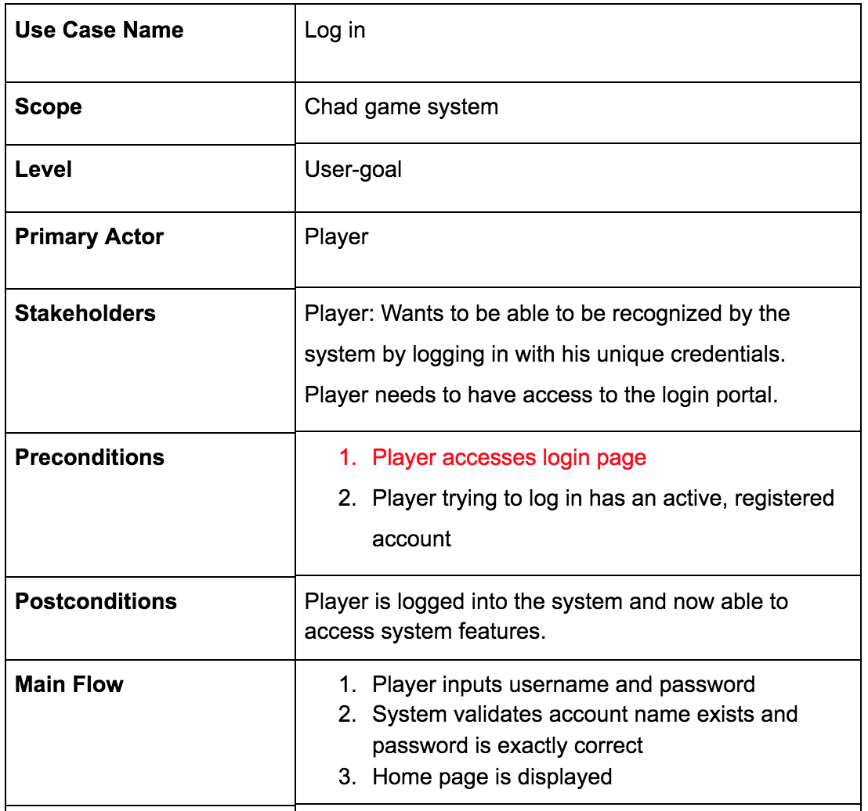
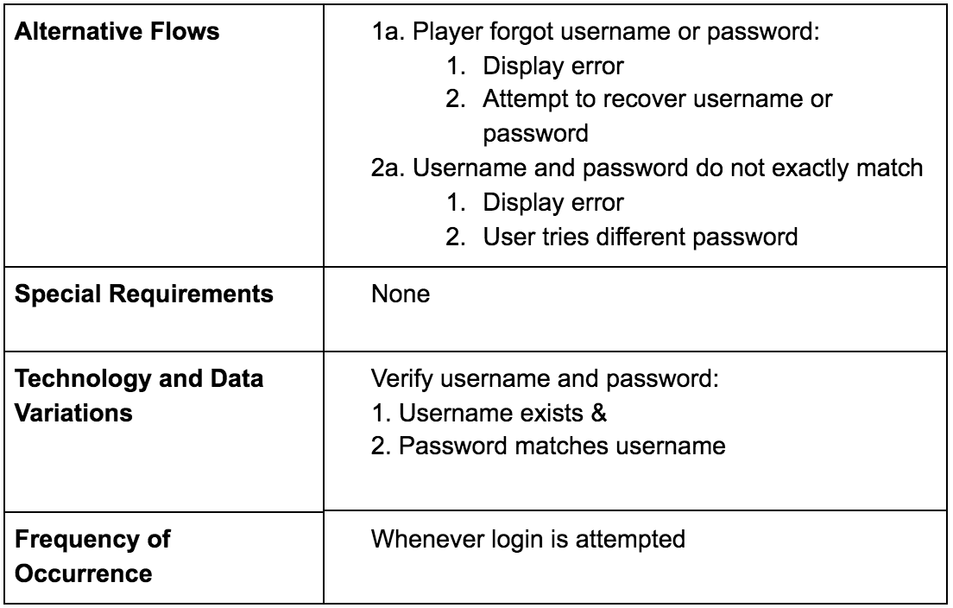
Use Case Document Example: Log in

Slide 4
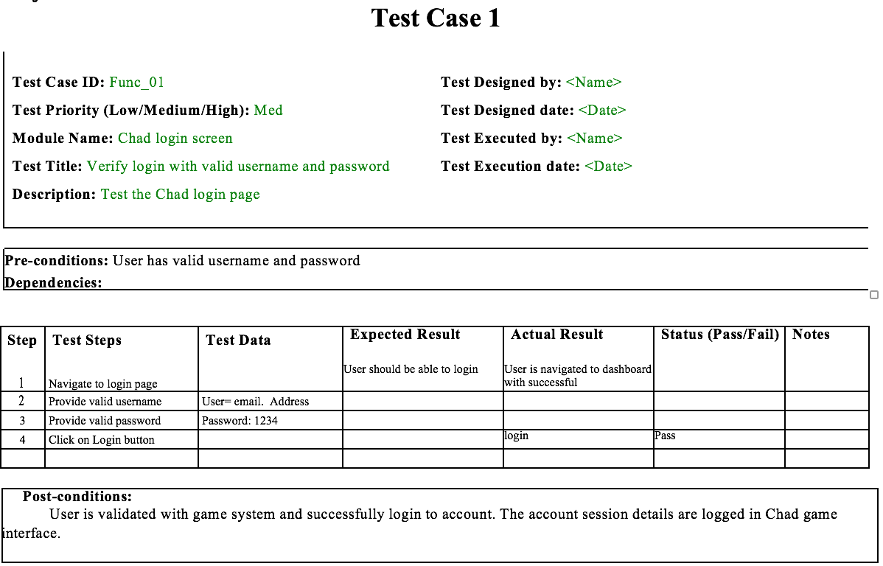
Testing Document: Example

Slide 5
Domain Model Document: Glossary
Player. A person who plays a game by moving pieces.
Player Profile. A profile of a player that has the players nickname and records the history of games played.
Game. A game of Chad between two players that has a unique ID and is played on a board. A game has a status that describes if the game is ready to play, currently being played, the player who’s turn is next, and the player who won.
Board. A 12 by 12 matrix in which a game is played on that contains 144 squares.
Square. A spot that a game piece is on or can be moved to with unique coordinates on the board.
Piece. An object that players move around the board on squares and is one of the following types:
King. A type of piece that can move and capture like a Chess king or Chess knight.
Queen. A type of piece that moves like a queen in chess.
Rook. A type of piece that moves like a rook in chess, and if ending on a square in the enemy castle, automatically promotes to a queen.

Slide 6
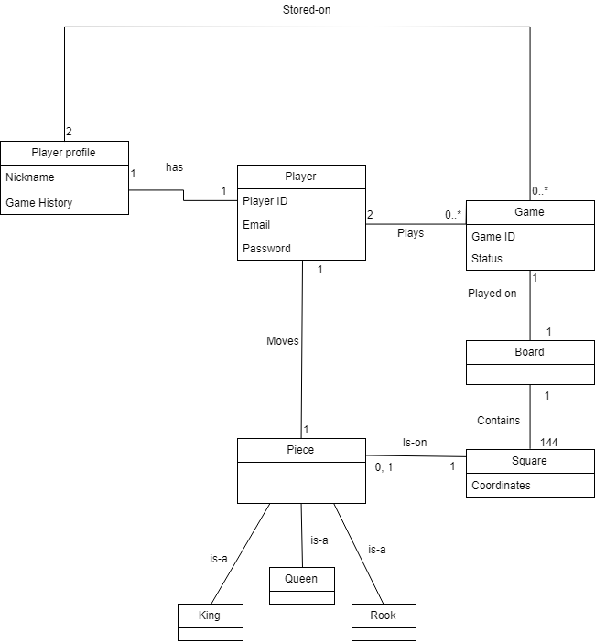
Domain Model Document: Diagram

Slide 7
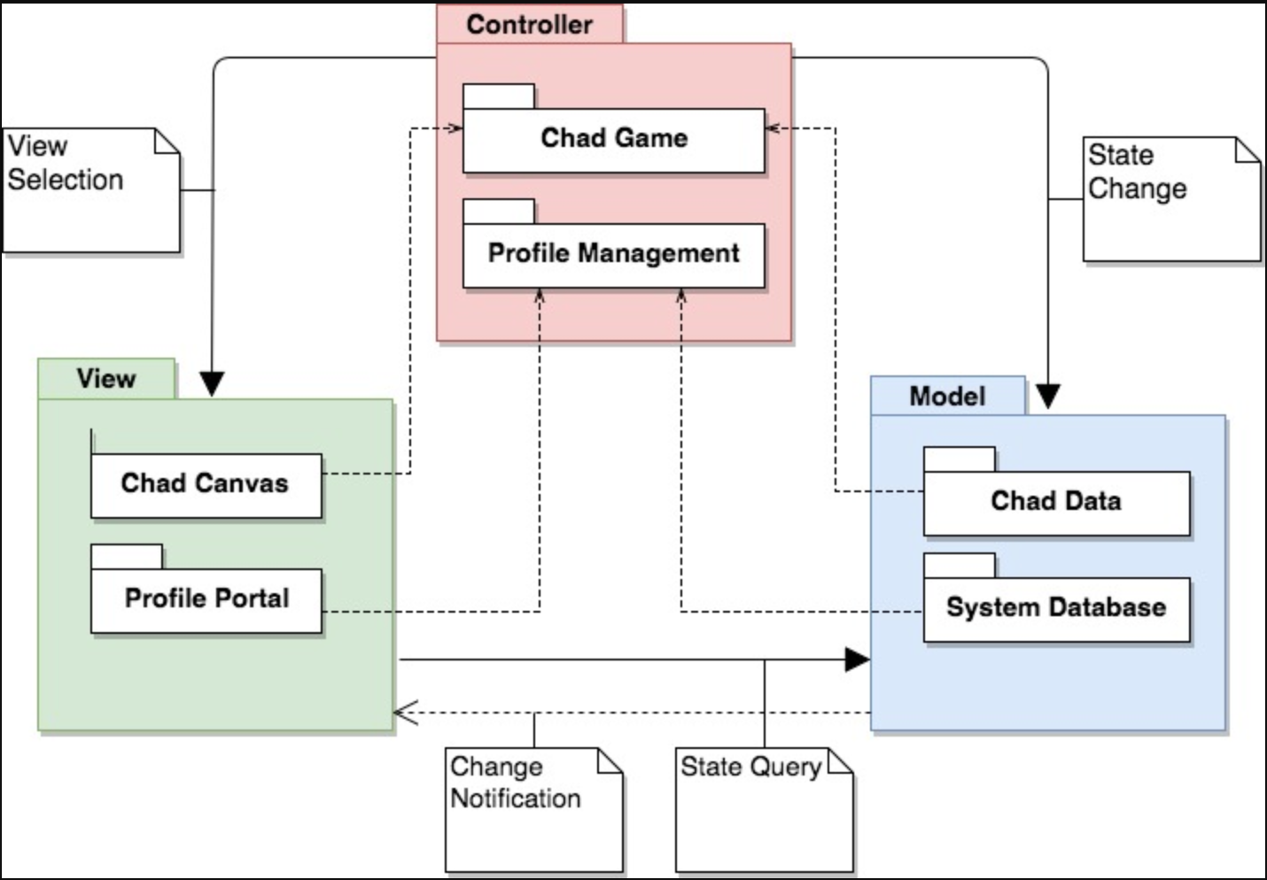
Design Document: Package Diagram

Slide 8
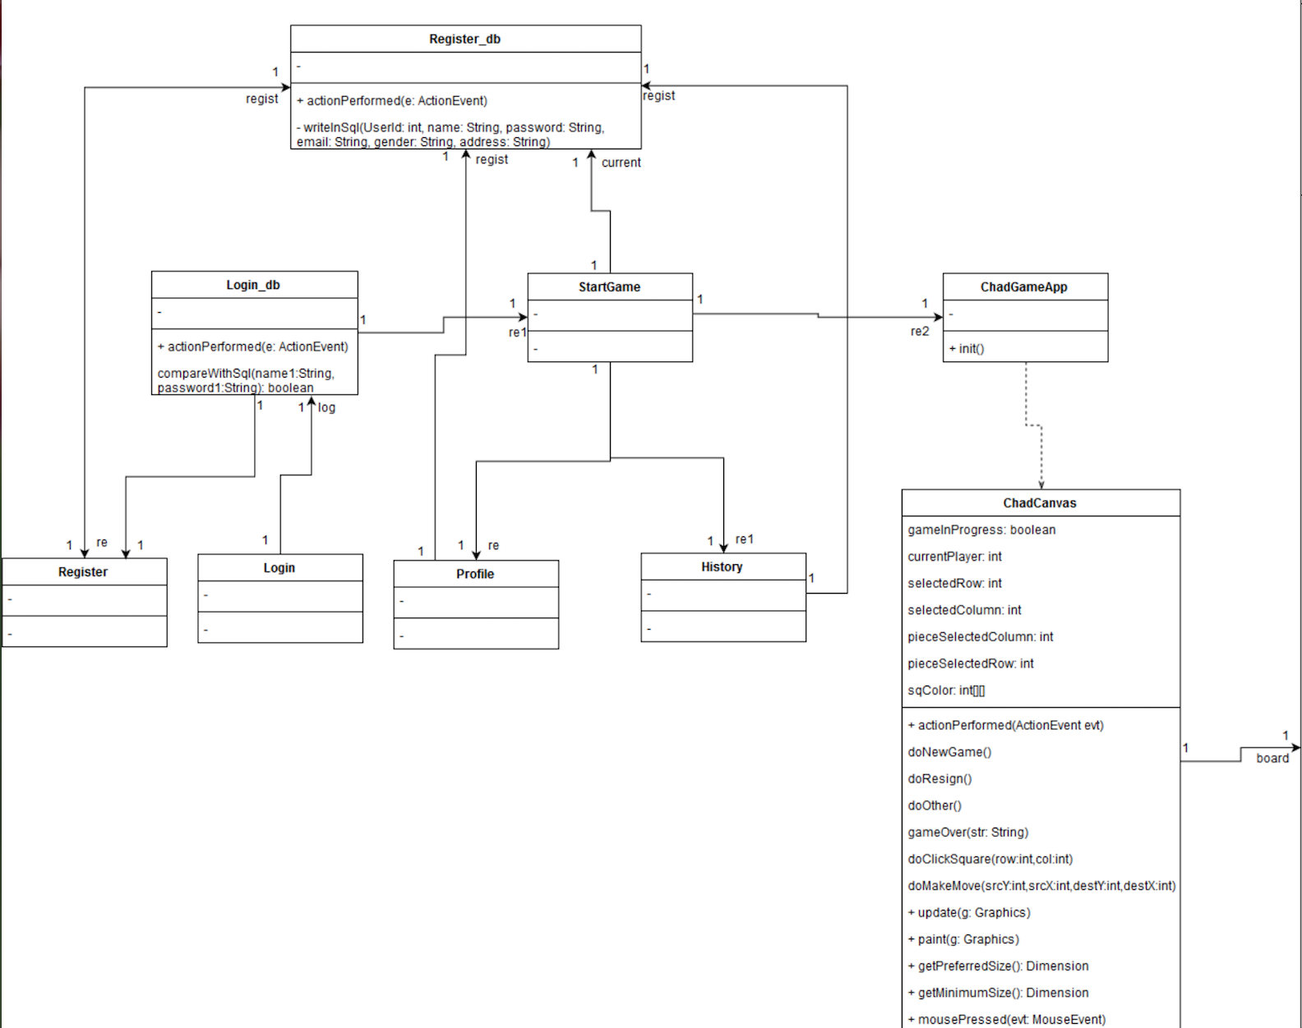
Design class diagram (1/2)

Slide 9
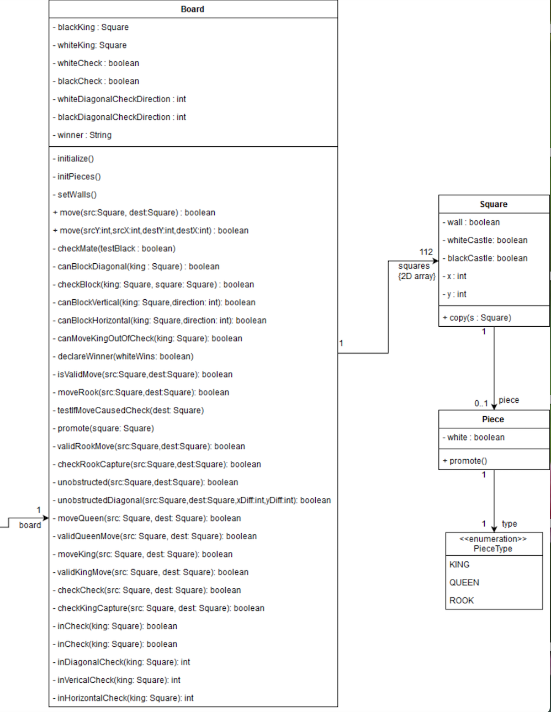
Design class diagram (2/2)

Slide 10
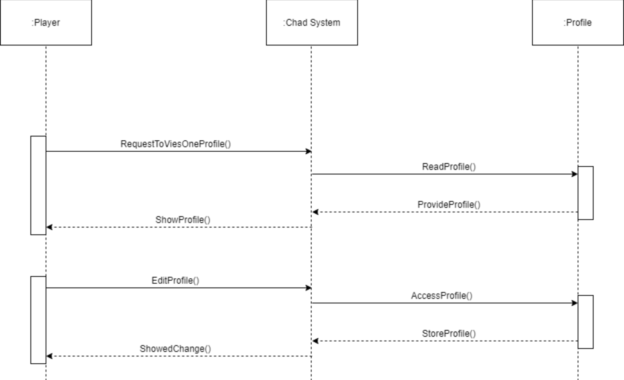
Sequence Diagram 1 - Viewing Profile

Slide 11
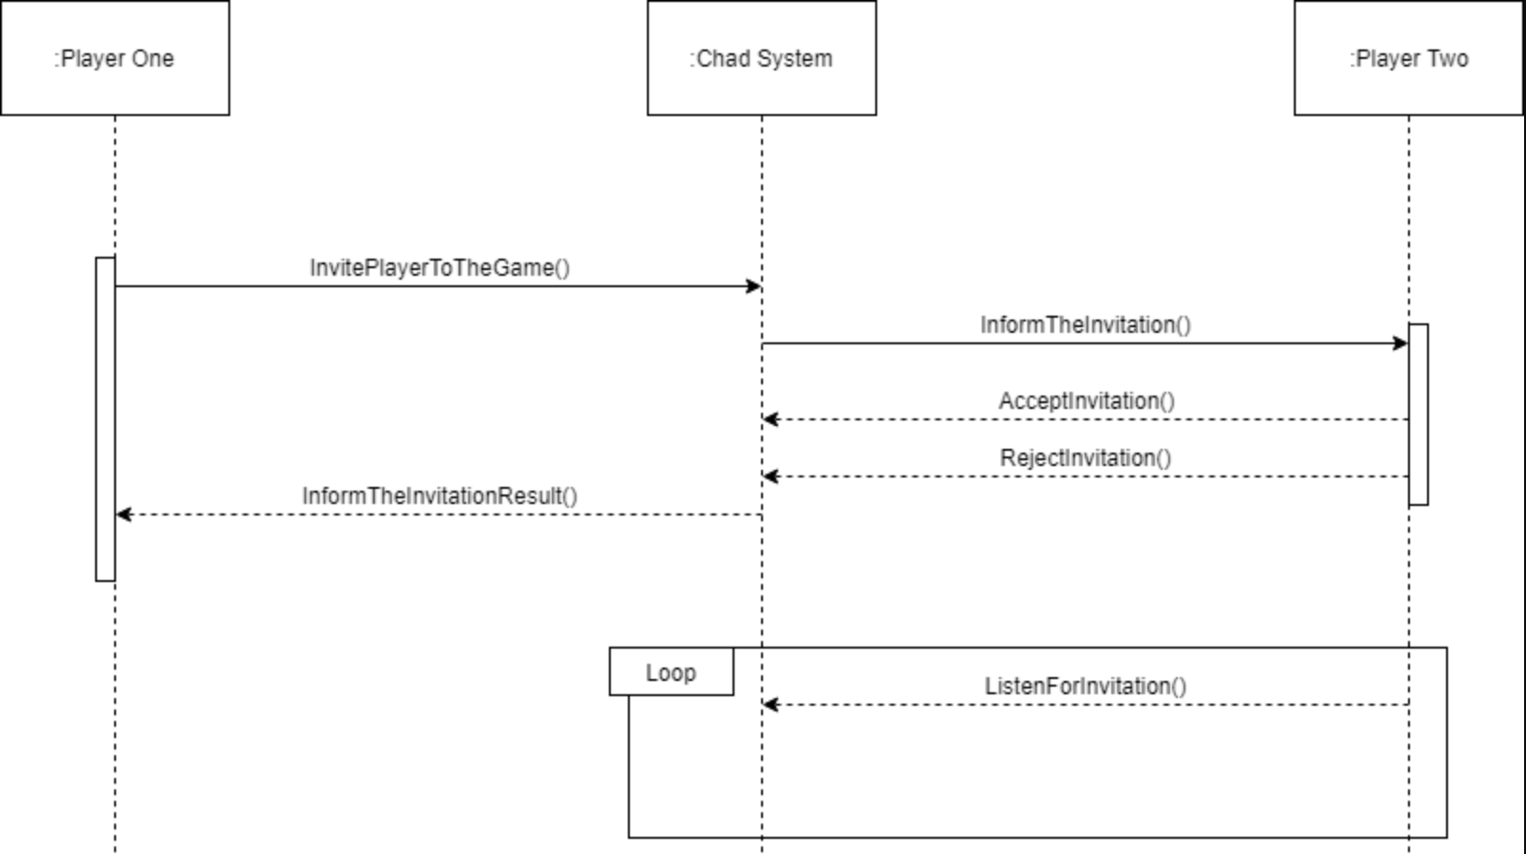
Sequence Diagram 2 - Invitation

Slide 12
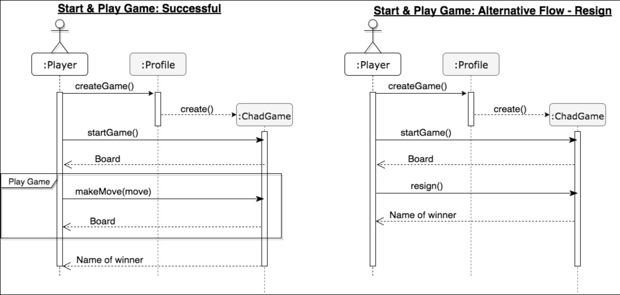
Updated sequence diagram 3 - Start & Play Game

Slide 13
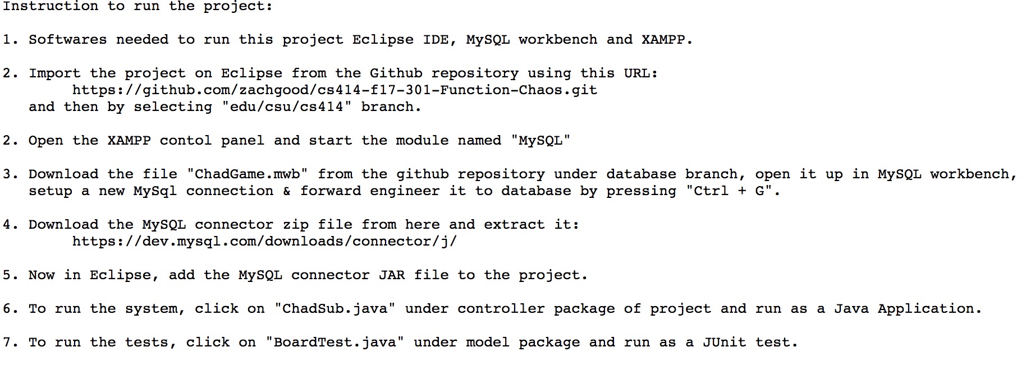
Development Manual

Slide 14
Refactoring and Design Pattern List
Board.java
Information Expert, because accesses information from multiple classes and uses it to fulfill requests
Square.java
Indirection, because it acts as an intermediate between Board and Piece
Piece.java
Low Coupling, because it has no dependencies on any other classes
ChadCanvas.java
Extract method: doMakeMove(..) extracted from doClickSquare(...)
Removed unused code
ChadGameApp.java
Move class: class moved to controller package to fit MVC

Slide 15
Refactoring and Design Pattern List (cont.)
History.java
Move to History. java from model to view package
Move Login button actionPerformed to class Login_db
Login.java
Move to Login. java from model to view package
Startgame.java
Move to Startgame. java from model to view package
Register.java
Move to Register. java from model to view package
Move Register button actionPerformed to class Register_db
Delete gender and address information from the profile.

Slide 16
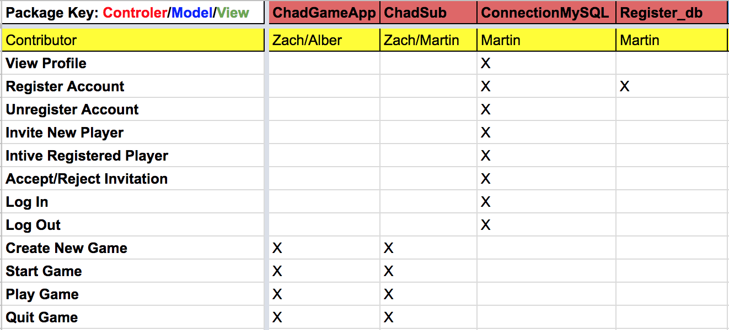
Traceability link matrix (1/3)

Slide 17
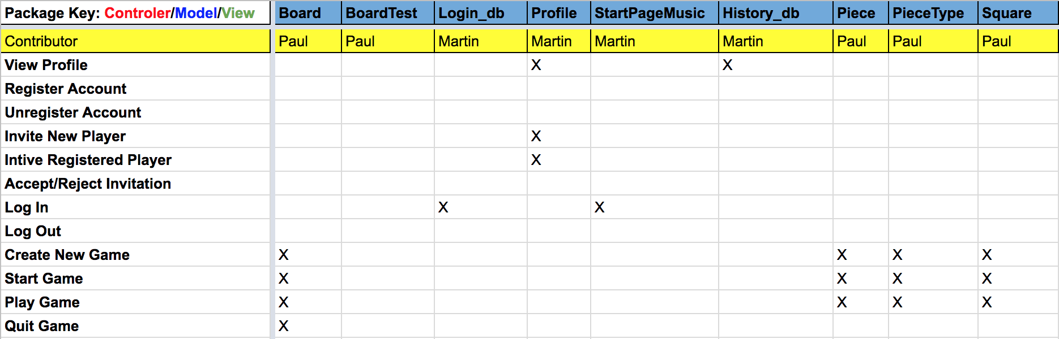
Traceability link matrix (2/3)

Slide 18
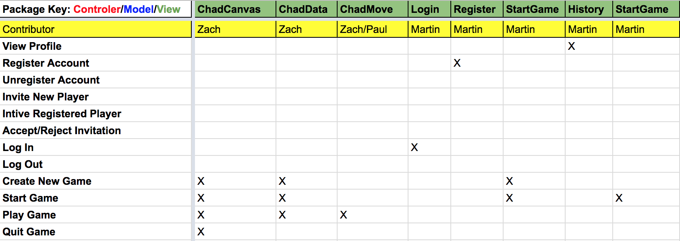
Traceability link matrix (3/3)

Slide 19
Challenges and Lessons Learned
Challenges
Coding collaboration
Time management
Separate group work
Group meetings
Lessons Learned
Diagrams, documents, and design patterns are important for communication
Focus on the basics first
Utilize everyone's strengths. Utilize tools (github, waffle.io, etc.). Spread work evenly.
Prepare before group meeting to improve efficiency

Slide 20
Demo
Using source code!

